Slide 1


Setting bots in twitter for automatic replies is risky (Courtesy of @narendramodi, Prime Minister Of India #MainBhiChowkidar)
Mohammed Nauman Siddique
Web Archiving Forensics (CS 895)
Spring, 2019
Web Science and Digital Libraries Group
Old Dominion University
Norfolk, Virginia, USA
@WebSciDL
2019/04/03

Slide 2
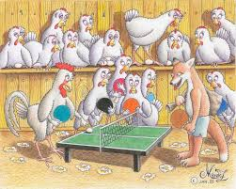
#MainBhiChowkidar
Main – Me
Bhi - Too
Chowkidar – Guard
#MainBhiChowkidar - I am also a guard (of country)
DON'T LET THE FOX GUARD THE HENHOUSE
Source: https://www.jla-asia.com/wp-content/uploads/fox-02.jpg

Slide 3
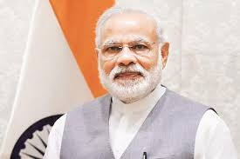
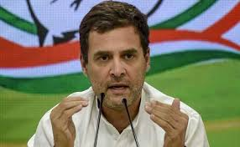

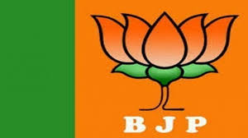
Brief about two major Indian political parties
Prime Minister
Opposition Leader
Ruling Party
Opposition Party

Slide 4
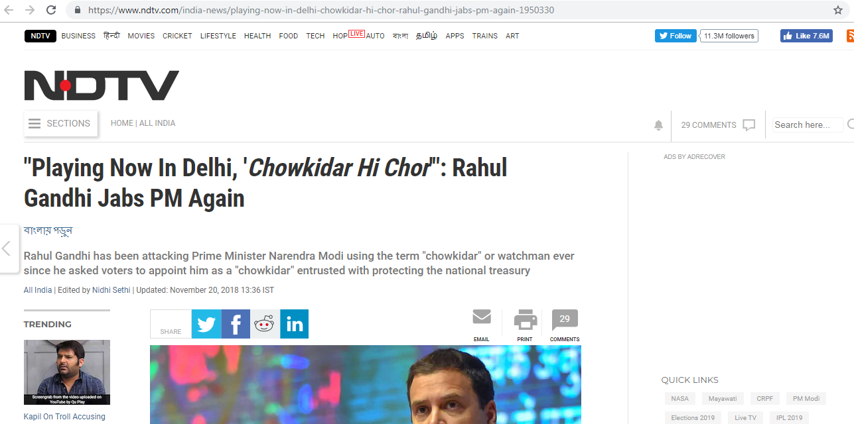
Opposition says “Chowkidar Hi Chor”
Source: https://www.ndtv.com/india-news/playing-now-in-delhi-chowkidar-hi-chor-rahul-gandhi-jabs-pm-again-1950330

Slide 5
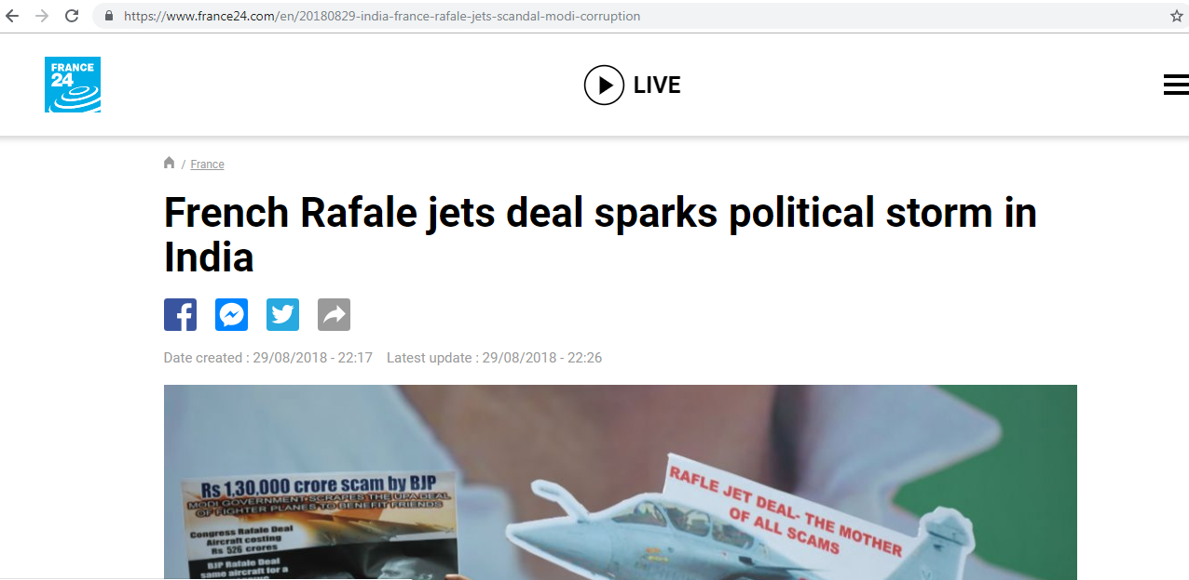
Corruption allegations against the Government over Rafale jets deal
Source: https://www.france24.com/en/20180829-india-france-rafale-jets-scandal-modi-corruption

Slide 6
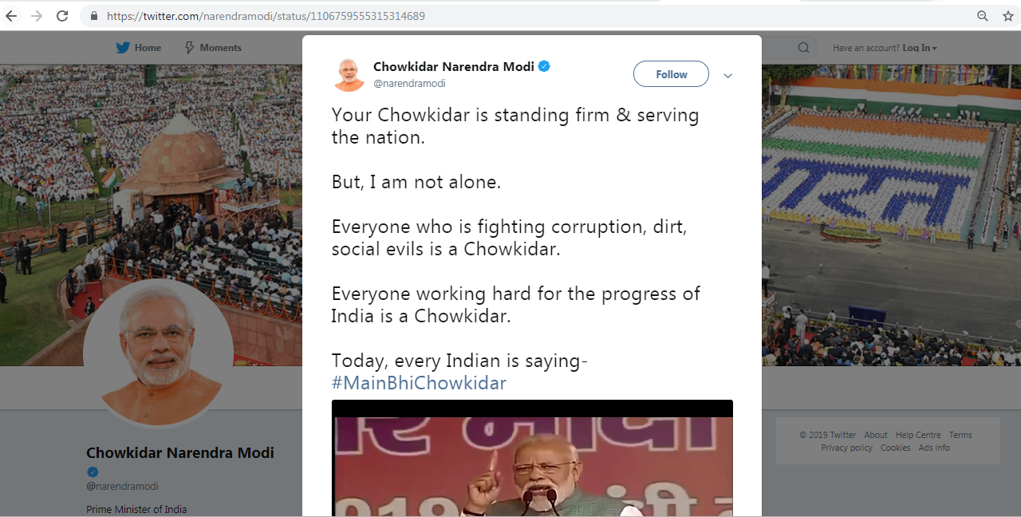
Prime Minister of India tweets about fighting against corruption with #MainBhiChowkidar
Source: https://twitter.com/narendramodi/status/1106759555315314689

Slide 7
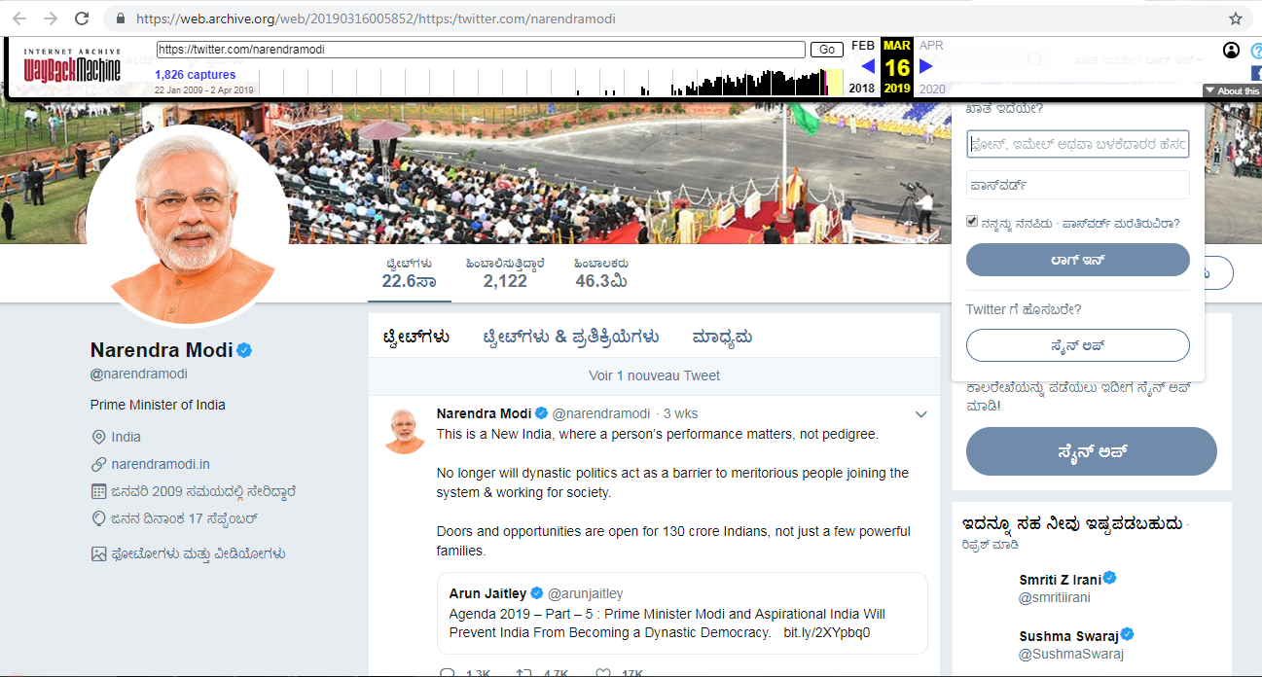
Memento for @narendramodi before #MainBhiChowkidar campaign
Source: https://web.archive.org/web/20190316005852/https:/twitter.com/narendramodi

Slide 8
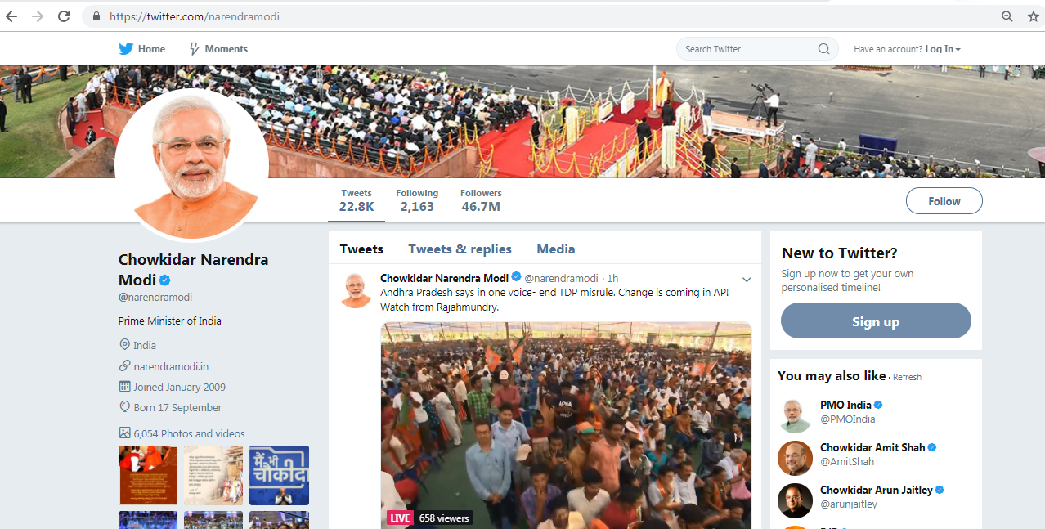
Prime Minister then adds Chowkidar to his name
Source: https://twitter.com/narendramodi

Slide 9
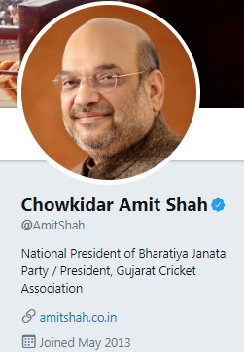
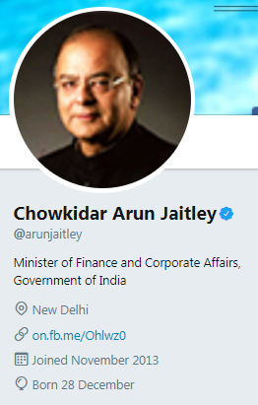
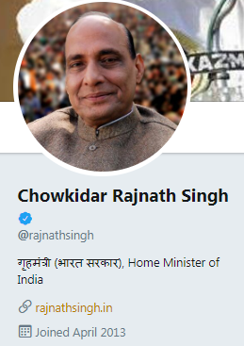
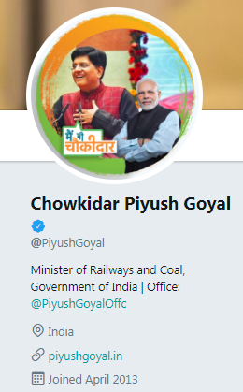
Ministers start to join the bandwagon by adding Chowkidar to their names
Party President
Finance Minister
Home Minister
Railway Minister

Slide 10
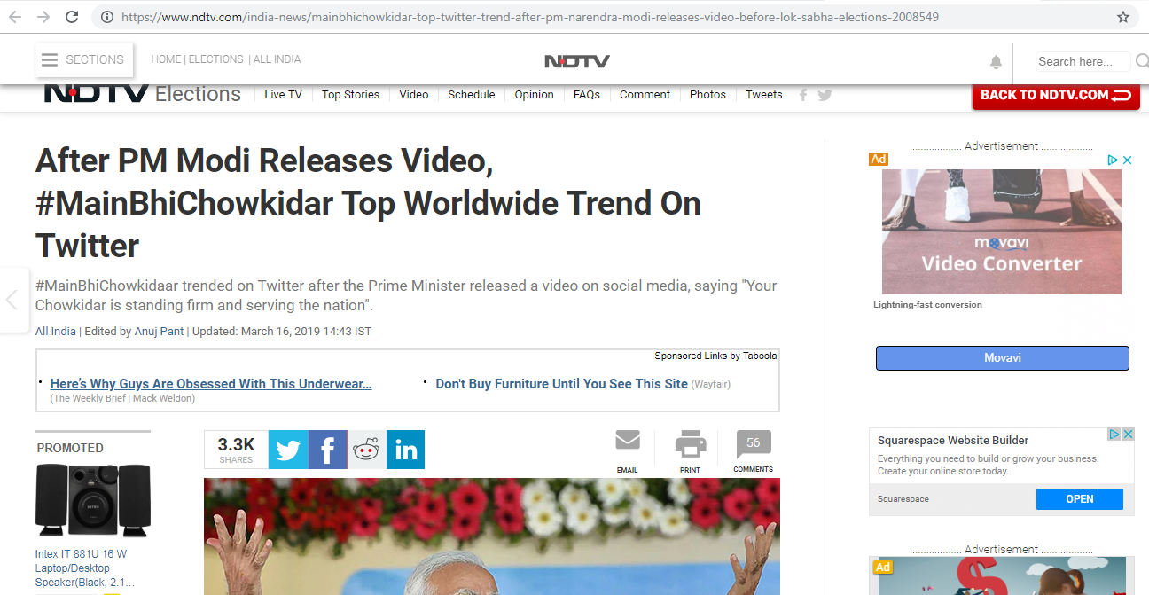
#MainBhiChowkidar trends on Twitter Worldwide
Source: https://www.ndtv.com/india-news/mainbhichowkidar-top-twitter-trend-after-pm-narendra-modi-releases-video-before-lok-sabha-elections-2008549

Slide 11
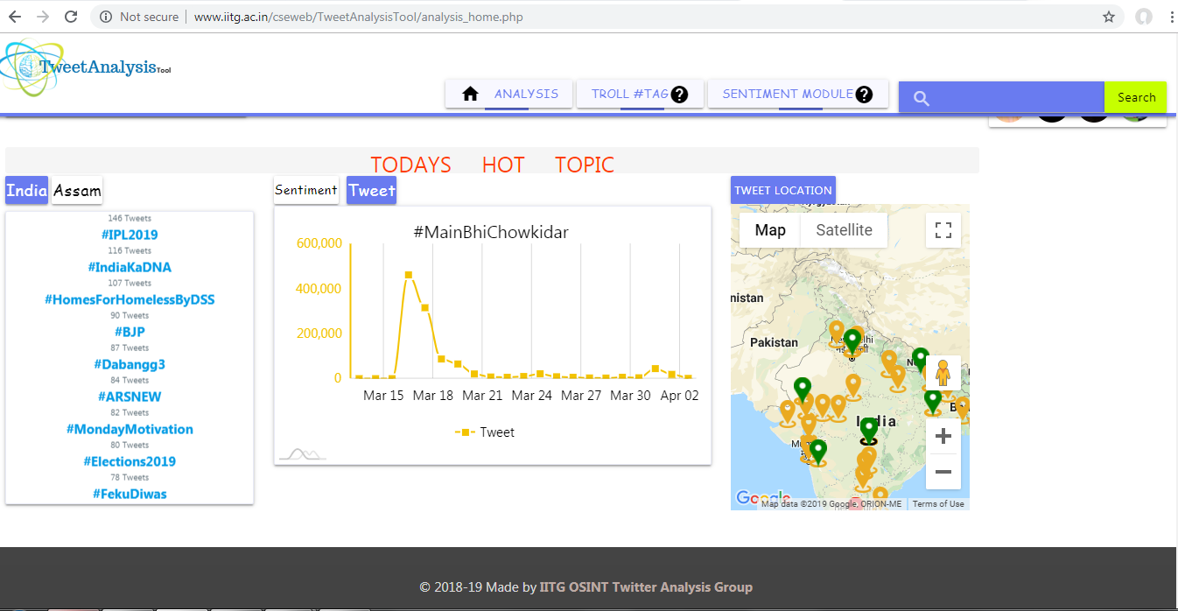
779,265 tweets with #MainBhiChowkidar between 2019-03-16 and 2019-03-17
Source: http://www.iitg.ac.in/cseweb/TweetAnalysisTool/analysis_home.php

Slide 12
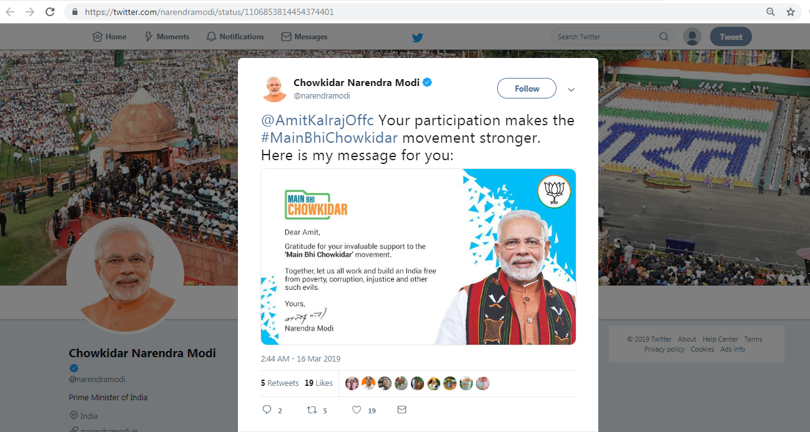
Received personalized reply from @narendramodi on using #MainBhiChowkidar
Source: https://twitter.com/narendramodi/status/1106853814454374401

Slide 13
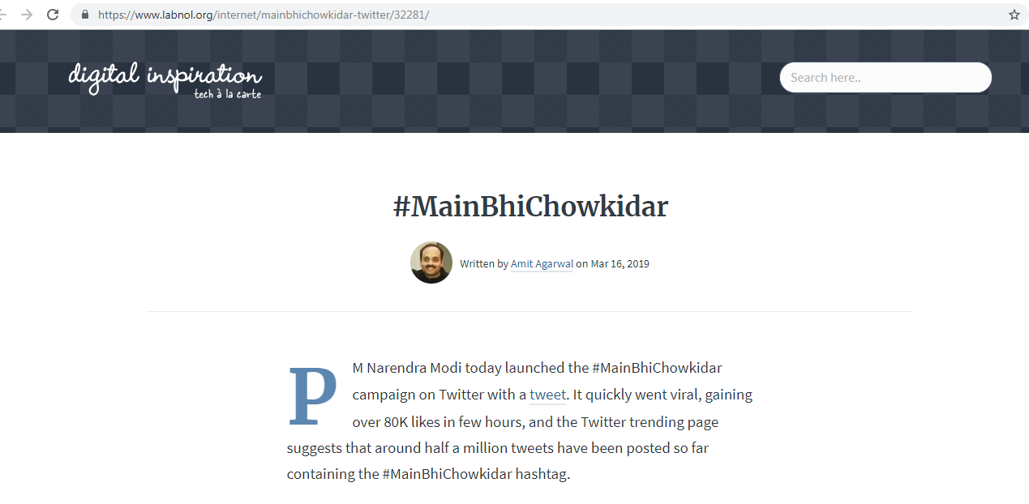
Some insights shared on hashtag
Source: https://www.labnol.org/internet/mainbhichowkidar-twitter/32281/

Slide 14
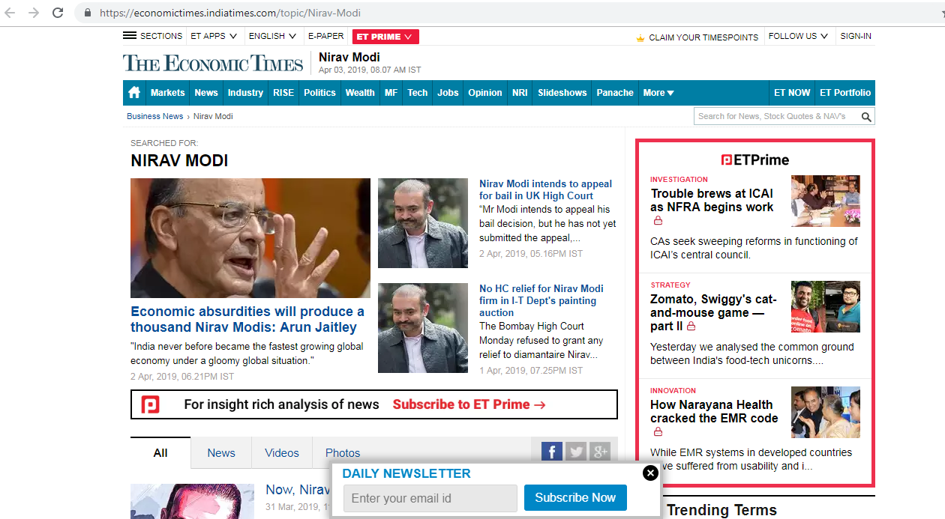
Nirav Modi ran away after borrowing US$2.1 billion from an Indian bank
Source: https://economictimes.indiatimes.com/topic/Nirav-Modi

Slide 15
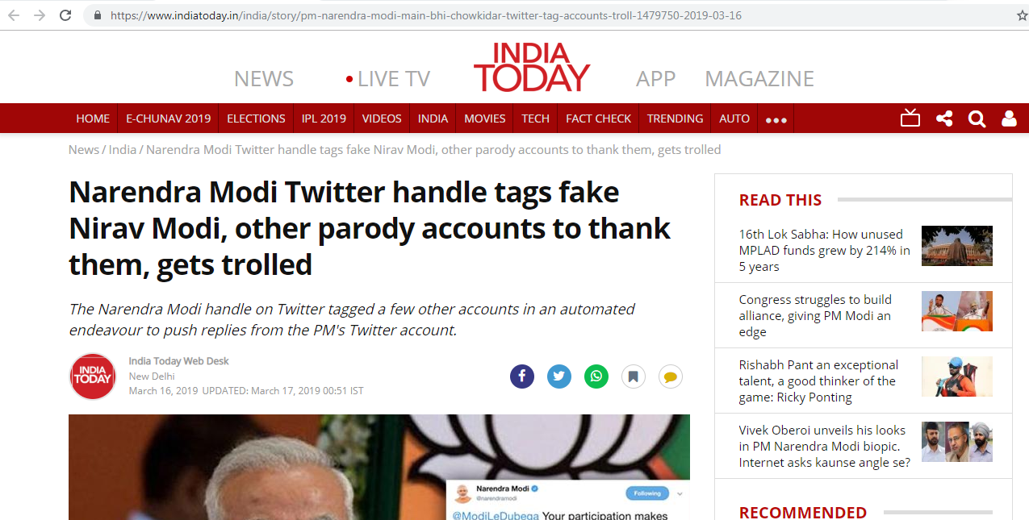
Parody accounts jump in
Source: https://www.indiatoday.in/india/story/pm-narendra-modi-main-bhi-chowkidar-twitter-tag-accounts-troll-1479750-2019-03-16

Slide 16
Parody account of the fugitive businessman
Source: https://twitter.com/niiravmodi

Slide 17
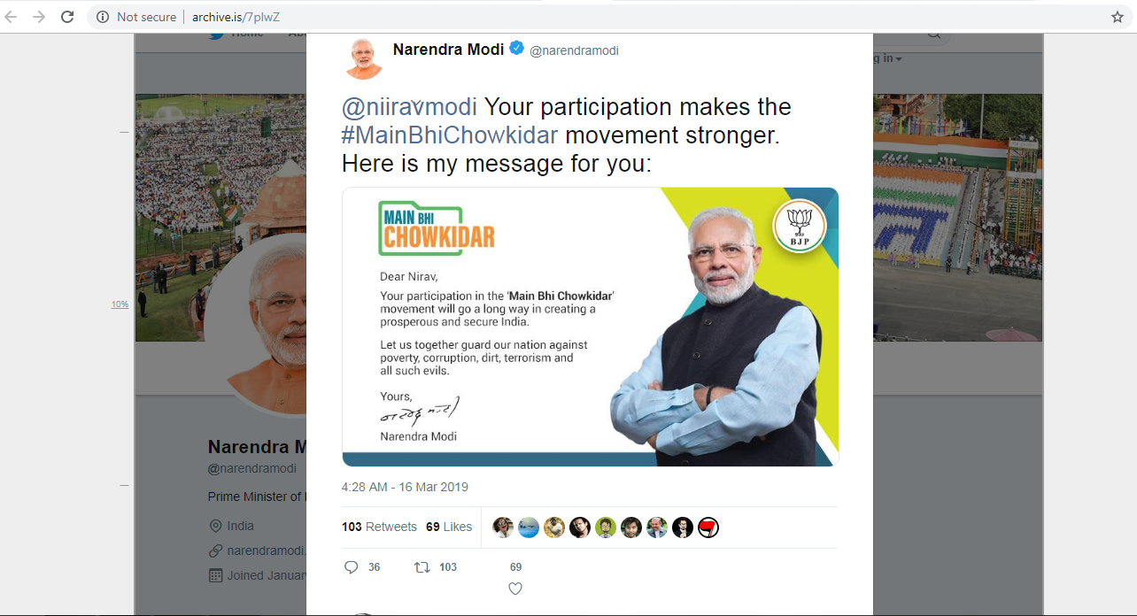
@narendramodi thanks @niiravmodi (parody account)
Source: http://archive.is/7plwZ

Slide 18
No more @narendramodi thanking @niiravmodi
msiddique@wsdl-3102-03:/data/Nauman/ForensicStudy$ curl -I https://twitter.com/narendramodi/status/1106879991604756480?s=19
HTTP/1.1 404 Not Found
cache-control: no-cache, no-store, must-revalidate, pre-check=0, post-check=0
content-length: 6329
date: Mon, 01 Apr 2019 23:31:48 GMT
expires: Tue, 31 Mar 1981 05:00:00 GMTlast-modified: Mon, 01 Apr 2019 23:31:48 GMT
…Deletia…

Slide 19
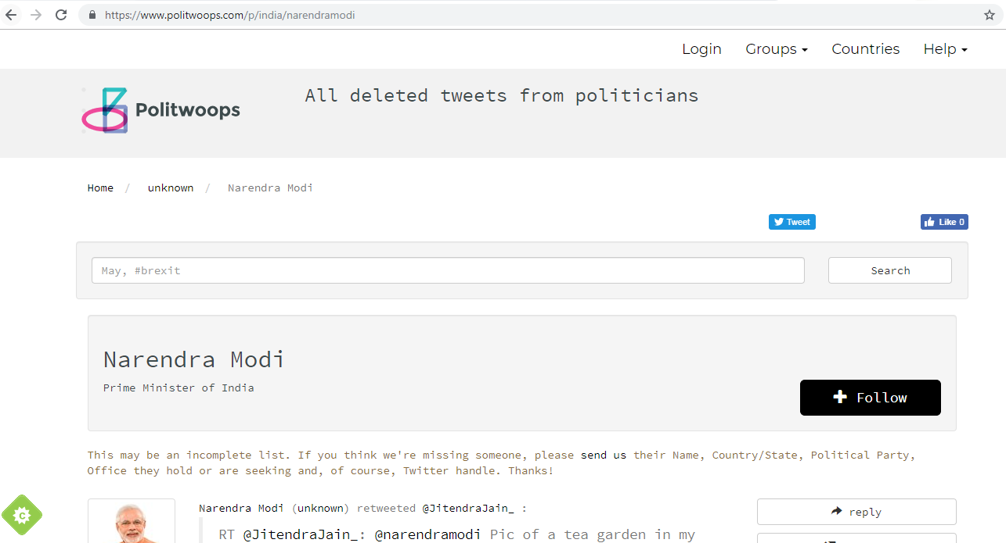
No deleted tweets with #MainBhiChowkidar
Source: https://www.politwoops.com/p/india/narendramodi

Slide 20
archive.is has a memento for deleted tweet
msiddique@wsdl-3102-03:/data/Nauman/ForensicStudy$ curl -v https://memgator.cs.odu.edu/timemap/link/https://twitter.com/narendramodi/status/1106879991604756480
….Deletia….
< HTTP/1.1 200 OK
< Access-Control-Allow-Origin: *
< Access-Control-Expose-Headers: Link, Location, X-Memento-Count, X-Generator
< Content-Length: 949
< Content-Type: application/link-format
< Date: Mon, 01 Apr 2019 23:39:39 GMT
< X-Generator: MemGator:1.0-rc7
< X-Memento-Count: 1
<
<http://archive.md/20190316121320/https://twitter.com/narendramodi/status/1106879991604756480>; rel="first last memento"; datetime="Sat, 16 Mar 2019 12:13:20 GMT",
…Deletia….

Slide 21
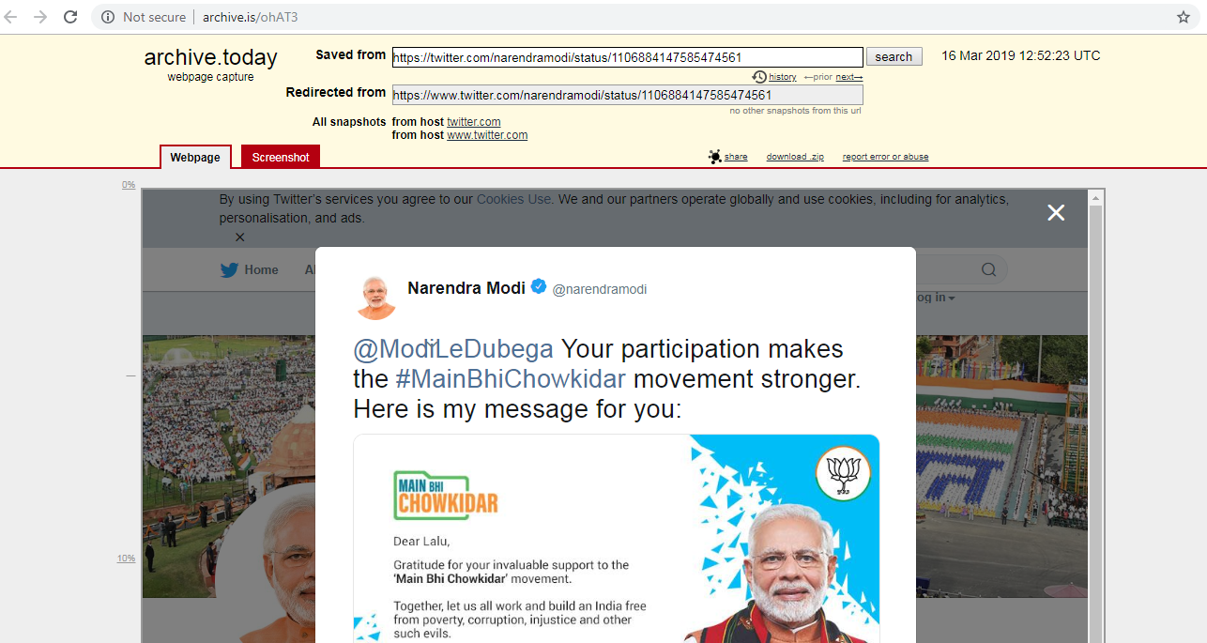
@ModiLeDubega (Modi will destroy us) receives a reply
Source: http://archive.is/ohAT3

Slide 22
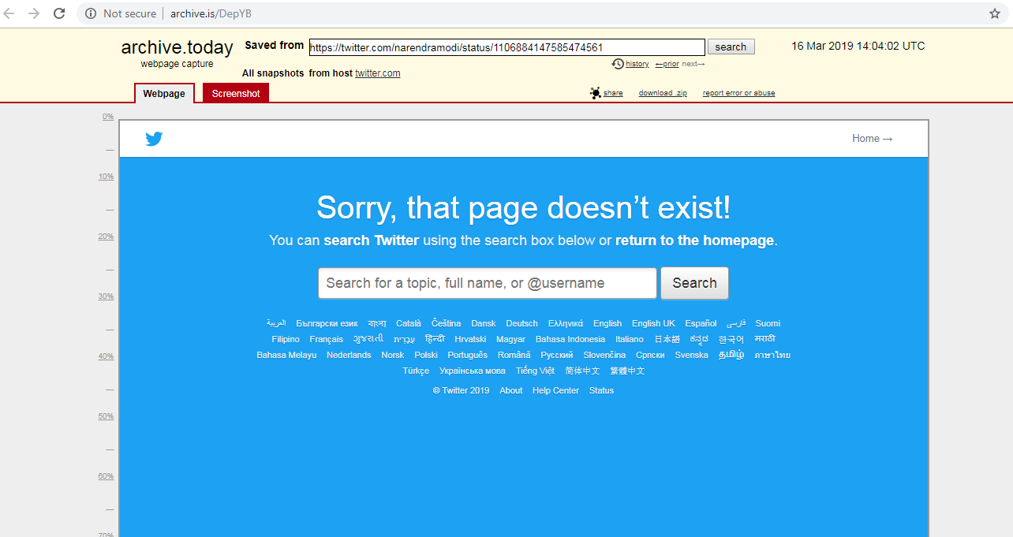
archive.is also has an archived 404 for reply sent to @ModiLeDubega from @narendramodi
Source: http://archive.is/DepYB

Slide 23
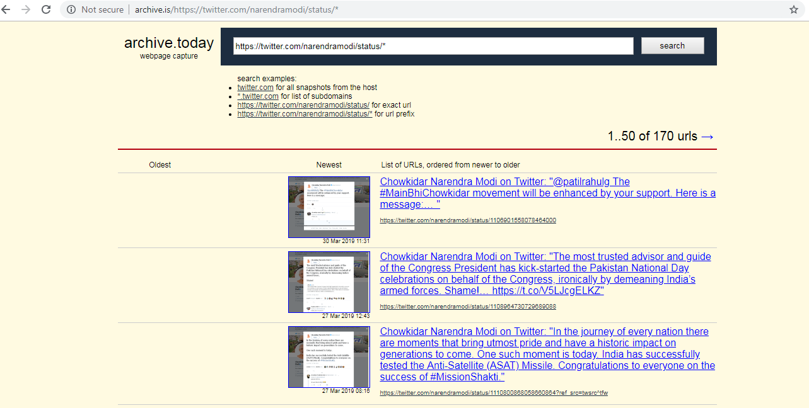
archive.is has more than 170 mementos for @narendramodi
Source: http://archive.is/https://twitter.com/narendramodi/status/*

Slide 24
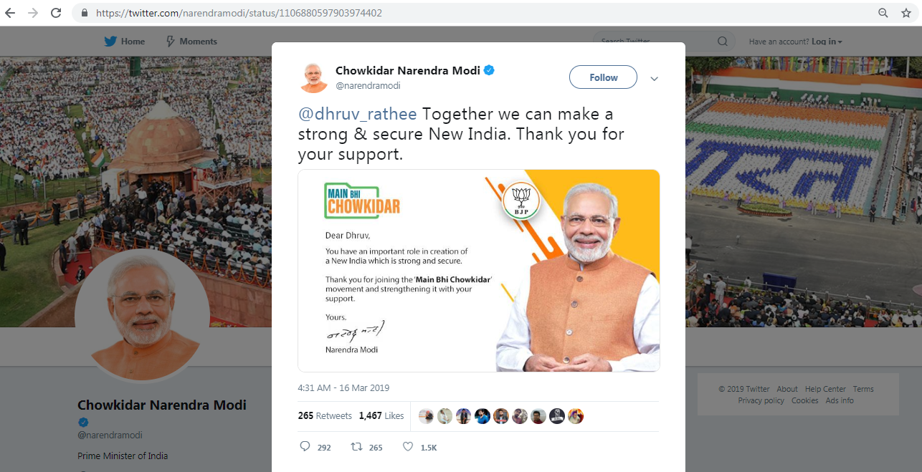
A Twitter bot was set up for sending personalized replies
Source: https://twitter.com/narendramodi/status/1106880597903974402

Slide 25
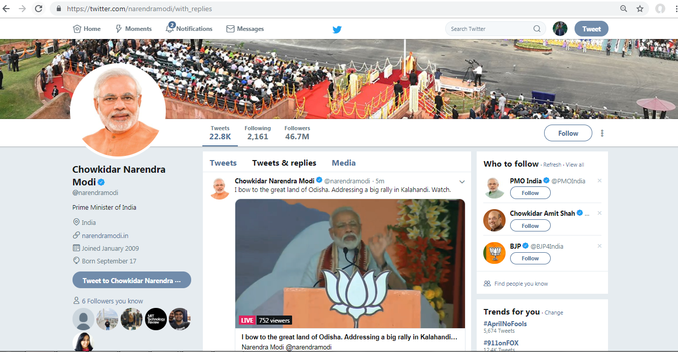
Replies appear in Tweet & replies tab
Source: https://twitter.com/narendramodi/with_replies

Slide 26
No memento for Tweet & replies after 2016-03-15
msiddique@wsdl-3102-03:/$ curl https://memgator.cs.odu.edu/memento/link/20190316050000/https://twitter.com/narendramodi/with_replies
<https://twitter.com/narendramodi/with_replies>;rel="original",
<http://web.archive.org/web/20160315080726/https://twitter.com/narendramodi/with_replies>; rel="first last memento"; datetime="Tue, 15 Mar 2016 08:07:26 GMT",
<https://memgator.cs.odu.edu/timemap/link/https://twitter.com/narendramodi/with_replies>; rel="timemap"; type="application/link-format",
<https://memgator.cs.odu.edu/timemap/json/https://twitter.com/narendramodi/with_replies>; rel="timemap"; type="application/json",
<https://memgator.cs.odu.edu/timemap/cdxj/https://twitter.com/narendramodi/with_replies>; rel="timemap"; type="application/cdxj+ors",
<https://memgator.cs.odu.edu/timegate/https://twitter.com/narendramodi/with_replies>; rel="timegate"

Slide 27
Tweets & replies URL redirects to login page
msiddique@wsdl-3102-03:/$ curl -IL https://twitter.com/narendramodi/with_replies
HTTP/1.1 302 Found
cache-control: no-cache, max-age=300
content-length: 124
content-type: text/html;charset=utf-8
date: Wed, 03 Apr 2019 08:38:23 GMT
expires: Wed, 03 Apr 2019 08:43:23 GMT
location: /login?redirect_after_login=%2Fnarendramodi%2Fwith_replies
….Deletia….
HTTP/1.1 200 OK
content-length: 221455
….Deletia….

Slide 28
Mementos for Tweets & replies end up at login page
msiddique@wsdl-3102-03:/$ curl -IL https://web.archive.org/web/20180125141011/https://twitter.com/realdonaldtrump/with_replies
HTTP/1.1 302 Found
Location: https://web.archive.org/web/20180125141011/https://twitter.com/login?redirect_after_login=%2FrealDonaldTrump%2Fwith_replies
…Deletia…
HTTP/1.1 302 FOUND
Location: https://web.archive.org/web/20180125165712/https://twitter.com/login?redirect_after_login=%2FrealDonaldTrump%2Fwith_replies
…Deletia…
HTTP/1.1 200 OK
…Deletia…

Slide 29
Promoted tweet from bot set up by OpalinaTech
{ "created_at":"Sat Mar 16 11:31:14 +0000 2019", "favorite_count":1466, "hashtags":[ ], "id":1106880597903974402, "id_str":"1106880597903974402", "in_reply_to_screen_name":"dhruv_rathee", "in_reply_to_user_id":730520573701443584, "lang":"en", "media":[ { } ], "retweet_count":265, "scopes":{ "followers":false }, "source":"<a href=\"http://www.opalina.in/\" rel=\"nofollow\">info 2019</a>", "text":"@dhruv_rathee Together we can make a strong &amp; secure New India. Thank you for your support. https://t.co/cvNDovELYs", "urls":[ ], "user":{ }, "user_mentions":[ ] }

Slide 30
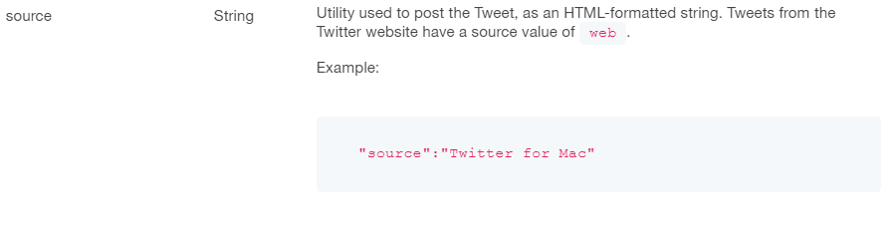
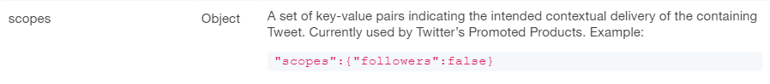
Understanding Twitter’s JSON response
Source: https://developer.twitter.com/en/docs/tweets/data-dictionary/overview/tweet-object

Slide 31
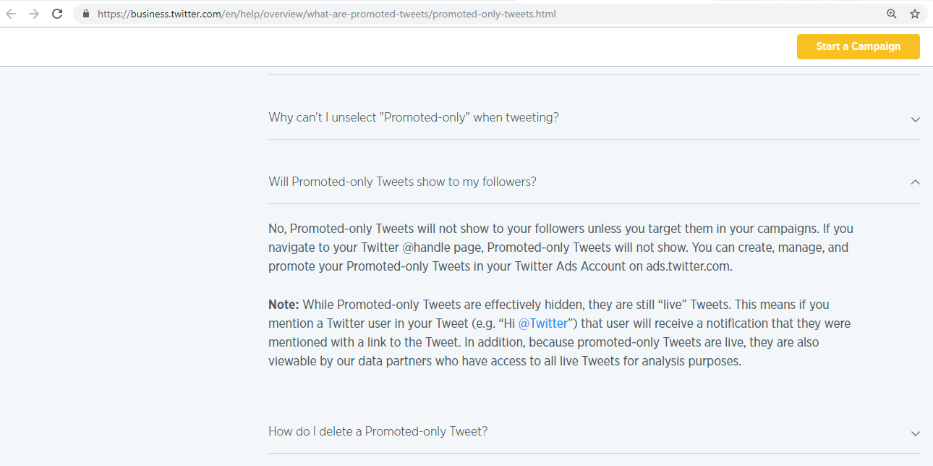
Promoted tweets are hidden but still live tweets
Source: https://business.twitter.com/en/help/overview/what-are-promoted-tweets/promoted-only-tweets.html

Slide 32
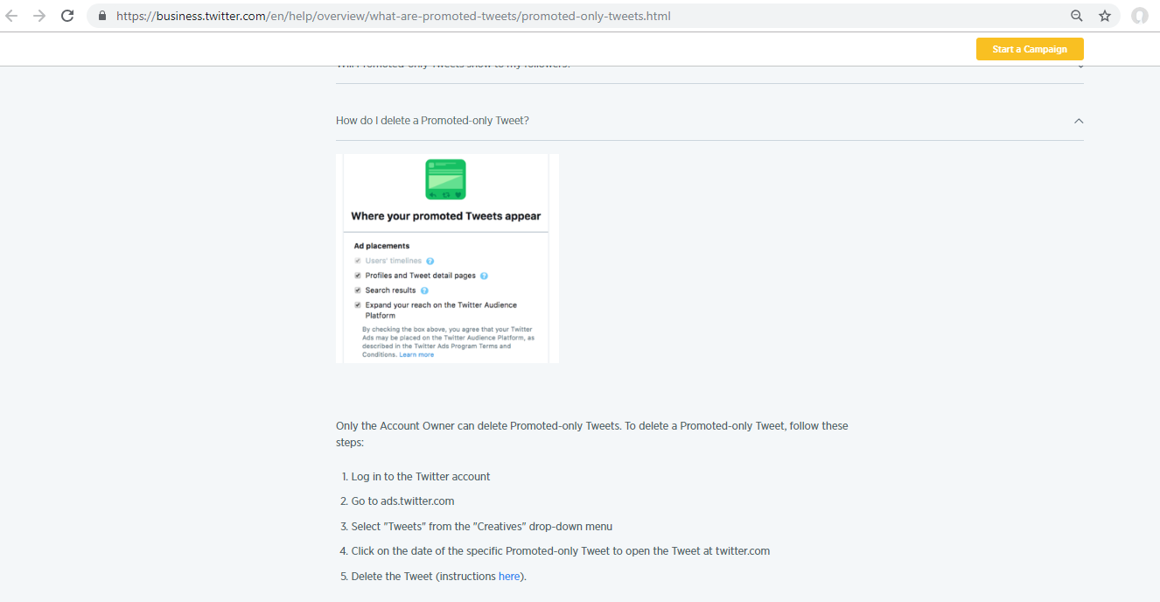
You can set promoted tweets appearance on Twitter
Source: https://business.twitter.com/en/help/overview/what-are-promoted-tweets/promoted-only-tweets.html

Slide 33
No bot reply shows up in Tweets & replies for #MainBhiChowkidar
Source: https://twitter.com/narendramodi/with_replies

Slide 34
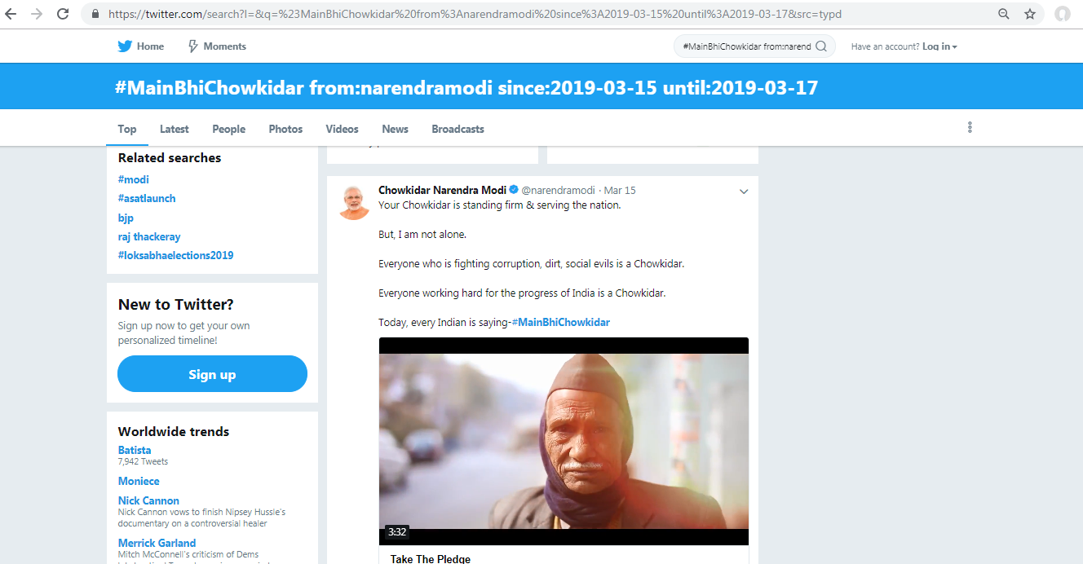
Only one tweet for #MainBhiChowkidar from @narendramodi
Source: https://twitter.com/search?l=&q=%23MainBhiChowkidar%20from%3Anarendramodi%20since%3A2019-03-15%20until%3A2019-03-17&src=typd

Slide 35
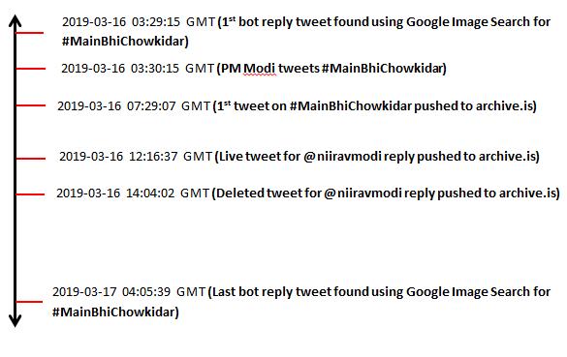
Timeline of events for #MainBhiChowkidar

Slide 36
#MainBhiChowkidar bot reply findings
A Twitter bot created by an Indian IT Firm, OpalinaTech followed #MainBhiChowkidar for automated reply.
It was a promoted tweet campaign.
Politwoops did not have any deleted tweets for @narendramodi due to replies being sent as promoted tweets which are live but hidden tweets.
Twitter search found one tweet with #MainBhiChowkidar and @narendramodi.
Google image search shows that, the Twitter bot was set up for replies for at least 24 hours since the campaign began.

Slide 37
Backup Slides

Slide 38
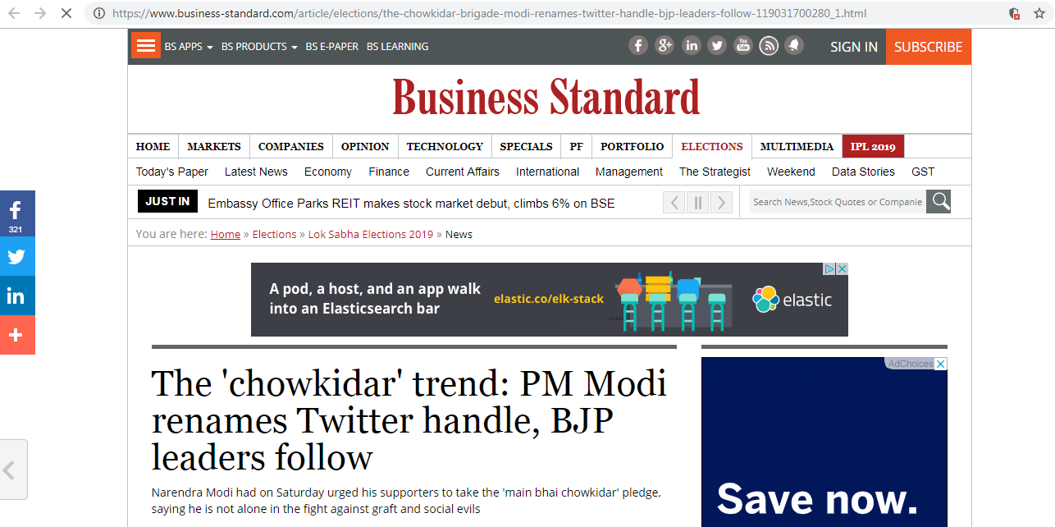
#MainBhiChowkidar hashtag trends
Source: https://www.business-standard.com/article/elections/the-chowkidar-brigade-modi-renames-twitter-handle-bjp-leaders-follow-119031700280_1.html

Slide 39
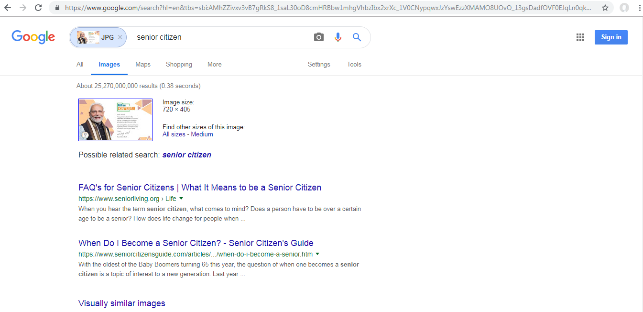
Image search on one of the images

Slide 40
Tweets found using Google Image Search for #MainBhiChowkidar
Tweet Id | Link to Image | Last Modified
1106759907515224066 | https://pbs.twimg.com/media/D1wARNyXcAAJxCR.jpg | Sat, 16 Mar 2019 03:29:38 GMT
1106761931027824640 | https://pbs.twimg.com/media/D1wCHBLWwAEXygO.jpg | Sat, 16 Mar 2019 03:37:40 GMT
1106762162792468480 | https://pbs.twimg.com/media/D1wCUiFWkAIXnbD.jpg | Sat, 16 Mar 2019 03:38:36 GMT
1106763370642976770 | https://pbs.twimg.com/media/D1wDa0eWwAI-fJj.jpg | Sat, 16 Mar 2019 03:43:24 GMT
1106775279215751169 | https://pbs.twimg.com/media/D1wOQArXgAUuXH0.jpg | Sat, 16 Mar 2019 04:30:43 GMT
1106776189392306176 | https://pbs.twimg.com/media/D1wPE_HWoAALzuy.jpg | Sat, 16 Mar 2019 04:34:20 GMT
1106797907200622592 | https://pbs.twimg.com/media/D1wi1HgX0AAOGwx.jpg | Sat, 16 Mar 2019 06:00:38 GMT

Slide 41
Tweet Id | Link to Image | Last Modified
1106813078862266369 | https://pbs.twimg.com/media/D1wwoNzWoAEuQke.jpg | Sat, 16 Mar 2019 07:00:55 GMT
1106813319447486465 | https://pbs.twimg.com/media/D1ww2McW0AA1uik.jpg | Sat, 16 Mar 2019 07:01:52 GMT
1106846294058954752 | https://pbs.twimg.com/media/D1xO1maWsAE4Kjo.jpg | Sat, 16 Mar 2019 09:12:54 GMT
1106848377034153984 | https://pbs.twimg.com/media/D1xQu2uWoAEA222.jpg | Sat, 16 Mar 2019 09:21:11 GMT
1106849236958789632 | https://pbs.twimg.com/media/D1xRg5jXQAAjVi0.jpg | Sat, 16 Mar 2019 09:24:36 GMT
 | https://pbs.twimg.com/media/D1xR-v-X4AA1Jlt.jpg | Sat, 16 Mar 2019 09:26:38 GMT
1106853814454374401 | https://pbs.twimg.com/media/D1xVrVXWsAAcuTh.jpg | Sat, 16 Mar 2019 09:42:47 GMT

Slide 42
Tweet Id | Link to Image | Last Modified
1106853991332438018 | https://pbs.twimg.com/media/D1xV1iTWkAE_qUP.jpg | Sat, 16 Mar 2019 09:43:29 GMT
 | https://pbs.twimg.com/media/D1xWTXzWoAAxlcG.jpg | Sat, 16 Mar 2019 09:45:31 GMT
1106857067783049216 | https://pbs.twimg.com/media/D1xYoshXcAA3sz-.jpg | Sat, 16 Mar 2019 09:55:43 GMT
1106867219579977728 | https://pbs.twimg.com/media/D1xh3j6WwAAaxxo.jpg | Sat, 16 Mar 2019 10:36:03 GMT
 | https://pbs.twimg.com/media/D1xiJGvWoAAG4xB.jpg | Sat, 16 Mar 2019 10:37:15 GMT
 | https://pbs.twimg.com/media/D1xipViW0AA5YTJ.jpg | Sat, 16 Mar 2019 10:39:27 GMT
1106868960941752320 | https://pbs.twimg.com/media/D1xjdADX4AEMyKk.jpg | Sat, 16 Mar 2019 10:42:58 GMT

Slide 43
Tweet Id | Link to Image | Last Modified
1106870935846600705 | https://pbs.twimg.com/media/D1xlP8TXgAIQ1hI.jpg | Sat, 16 Mar 2019 10:50:49 GMT
1106877929307426816 | https://pbs.twimg.com/media/D1xrnBLXgAAePRq.jpg | Sat, 16 Mar 2019 11:18:37 GMT
1106878491453214720 | https://pbs.twimg.com/media/D1xsHu9XQAE4b6F.jpg | Sat, 16 Mar 2019 11:20:51 GMT
1106880021162012678 | https://pbs.twimg.com/media/D1xtgvjXQAAAUl4.jpg | Sat, 16 Mar 2019 11:26:55 GMT
 | https://pbs.twimg.com/media/D1xtoj0W0AEzZ4h.jpg | Sat, 16 Mar 2019 11:27:27 GMT
1106880597903974402 | https://pbs.twimg.com/media/D1xuCWBWwAEq8vg.jpg | Sat, 16 Mar 2019 11:29:13 GMT
 | https://pbs.twimg.com/media/D1xuqqrWkAUHNXC.jpg | Sat, 16 Mar 2019 11:31:58 GMT

Slide 44
Tweet Id | Link to Image | Last Modified
1106883015597268994 | https://pbs.twimg.com/media/D1xwPExX4AAy9LN.jpg | Sat, 16 Mar 2019 11:38:49 GMT
1106883104621453312 | https://pbs.twimg.com/media/D1xwUOmWoAExUF7.jpg | Sat, 16 Mar 2019 11:39:10 GMT
 | https://pbs.twimg.com/media/D1xxQCpXcAE9Ypu.jpg | Sat, 16 Mar 2019 11:43:15 GMT
1106884149472829440 | https://pbs.twimg.com/media/D1xxRDrXcAAtz_N.jpg | Sat, 16 Mar 2019 11:43:20 GMT
1106890496964595712 | https://pbs.twimg.com/media/D1x3CgLUgAEy7mx.jpg | Sat, 16 Mar 2019 12:08:33 GMT
 | https://pbs.twimg.com/media/D1x-zJWXcAArUv4.jpg | Sat, 16 Mar 2019 12:42:27 GMT
1106901684519882752 | https://pbs.twimg.com/media/D1yBNsYWsAEMnUg.jpg | Sat, 16 Mar 2019 12:53:00 GMT

Slide 45
Tweet Id | Link to Image | Last Modified
1106901713947185152 | https://pbs.twimg.com/media/D1yBPdaXcAAtSRp.jpg | Sat, 16 Mar 2019 12:53:07 GMT
1106902219260080129 | https://pbs.twimg.com/media/D1yBs5ZW0AEi_A2.jpg | Sat, 16 Mar 2019 12:55:08 GMT
1106902974234808322 | https://pbs.twimg.com/media/D1yCY1kXgAAOo2i.jpg | Sat, 16 Mar 2019 12:58:08 GMT
1106903738529263616 | https://pbs.twimg.com/media/D1yDFUqXgAAkld-.jpg | Sat, 16 Mar 2019 13:01:10 GMT
1106903848348762118 | https://pbs.twimg.com/media/D1yDLsOW0AE4FTf.jpg | Sat, 16 Mar 2019 13:01:36 GMT
1106904210208112641 | https://pbs.twimg.com/media/D1yDgv5XQAAhvdI.jpg | Sat, 16 Mar 2019 13:03:02 GMT
1106904518539837440 | https://pbs.twimg.com/media/D1yDyt0WwAANpXx.jpg | Sat, 16 Mar 2019 13:04:16 GMT

Slide 46
Tweet Id | Link to Image | Last Modified
1106904600139972610 | https://pbs.twimg.com/media/D1yD3aDWsAAan4w.jpg | Sat, 16 Mar 2019 13:04:35 GMT
1106904807376330752 | https://pbs.twimg.com/media/D1yEDgPX4AI9UTe.jpg | Sat, 16 Mar 2019 13:05:25 GMT
1106905135211515904 | https://pbs.twimg.com/media/D1yEWlyWkAACzMv.jpg | Sat, 16 Mar 2019 13:06:43 GMT
 | https://pbs.twimg.com/profile_images/1107131356650356736/PShkzSh7.jpg | Sun, 17 Mar 2019 04:05:39 GMT

